Slide 1
Complete Examples of Mechatronic Control System
Chapter 4

Slide 2
What's inside
Give concepts of mechtronic control system
Open loop and close loop (feedback control)
How to do real mechtronic system with Arduino

Slide 3
Examples of Mechatronic Control System
Temperature control
DC motor control
DC motor feedback control

Slide 4
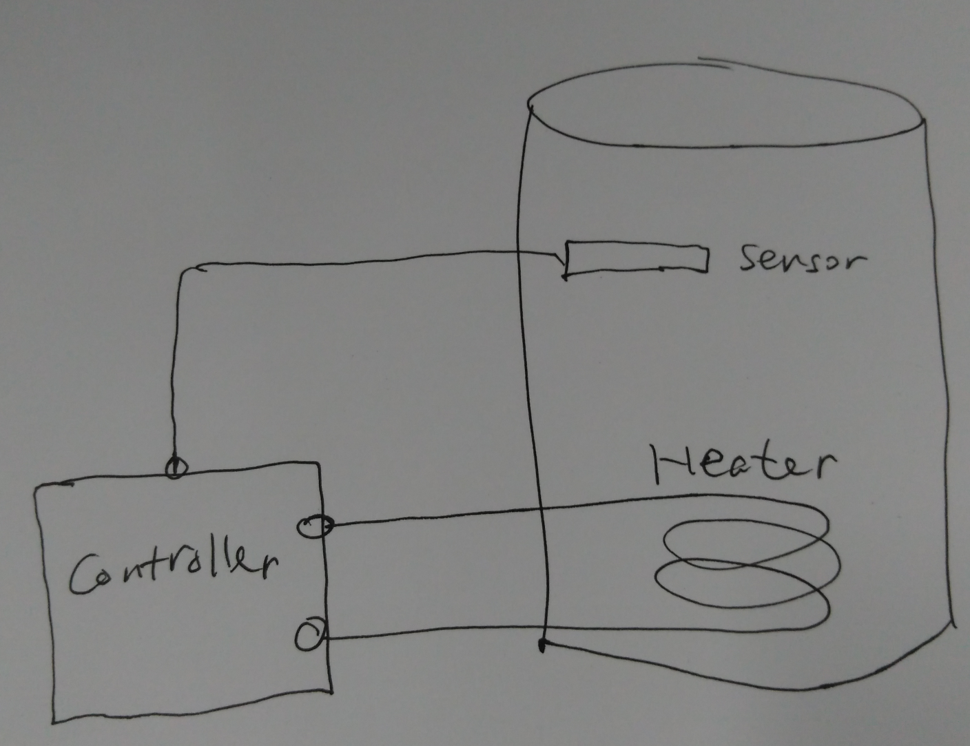
Temperature Control System

Slide 5
Temperature Control System
Sensor (Transducer)
Analog or Digital
Actuator (Transducer, Heater)
Controller
Interface (Hardware)
Algorithms (Software)
Bang-Bang Controller
PID controller
Hardware-software coupling

Slide 6
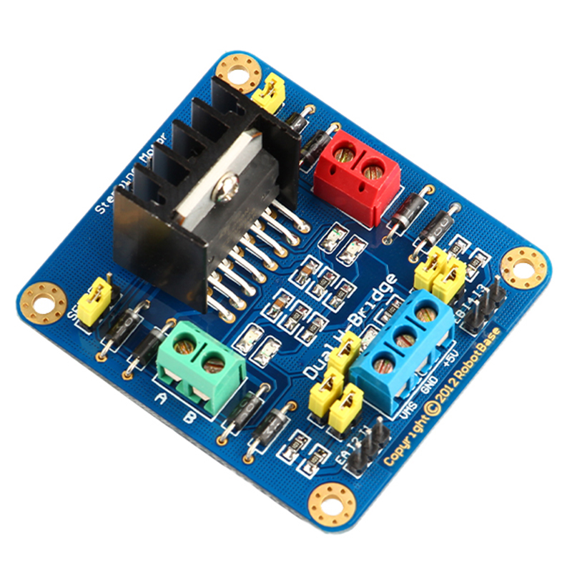
DC-Motor Control
How DC motor works
DC-motor driver
H-Bridge Circuit
PWM
Inteface
PWM <-> Speed
DO <-> Direction

Slide 7
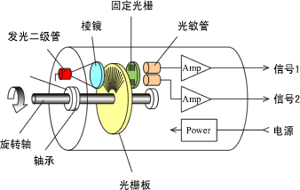
DC-Motor Control
Software Algorithms:
Open-loop:
analogWrite(pwmPort, speed)
digitalWrite(dirPort, dir)
Close-loop:
feedback control (PID)
Optical Encoder

Slide 8
DC-Motor Feedback Control
Velocity Control
Inner-loop
Position Control
Outer-loop
Speed sensor or Position sensor?
Speed: integral
Positon: differential

Slide 9
Conclusion
Pattern: "Sensor + Arduino + Actuator"
Software: Algorithms & Control Cycle

